Slide 1
OKC Quality Staff Meeting
8/30/16

Slide 2

Agenda
Safety Moment
Waterfall Communication
Updates
Wrap up
2
Notes:
2

Slide 3

Safety Moment
3
Notes:
3

Slide 4
Waterfall Communication
Audit
Nutron:
  CSA, Certs, QPs/ITPs, Documentation
Inspection helping breakdown
Next week topic: Soel on accessing standards with IHS
4
Notes:
4

Slide 5


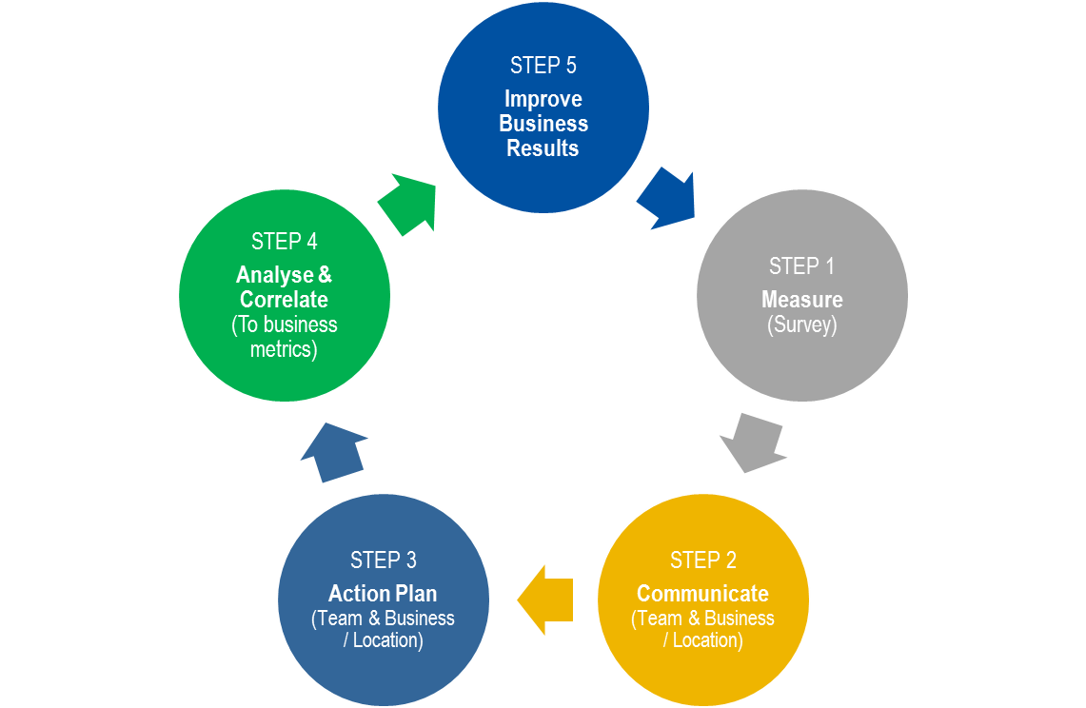


E2E
All employees complete the on-line survey* beginning September 1st
We will review the results as a team and plan follow-up actions
5
Notes:
5

Slide 6
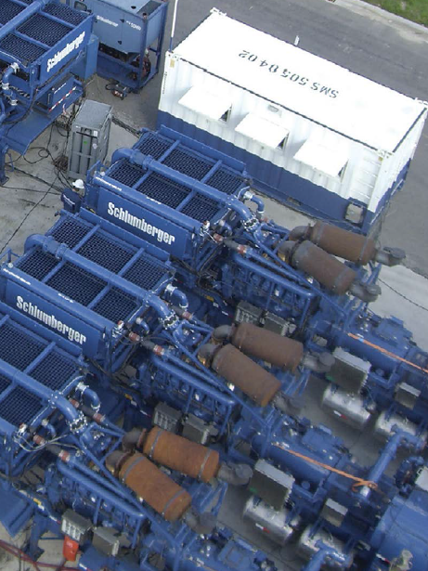

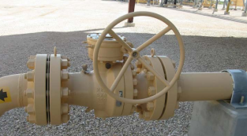
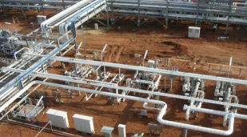
Updates
6
Notes:
AK: CCM
JW: New layout
SS: PCP for Demco, rework so high for APR-16?, FPY data slices, CARs
RL: ITP project, RRK, CRI
RC:
6

